Slide 1
Step 1: Generating your Market Opportunity Set

Slide 2
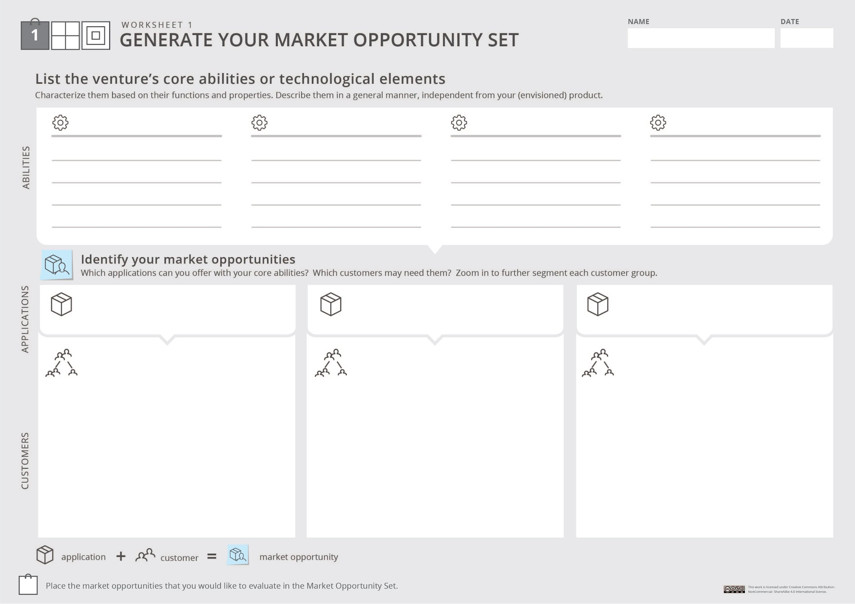

Your project/ startup
Instructions:
Fill in Worksheet 1 : list your unique abilities, the applications that can be created with them, and the different customers who may need these applications. Be creative and unconstrained!
Unique ability #1
Unique ability #2
Unique ability #3
Unique ability #4
Functions and properties
Functions and properties
Functions and properties
Functions and properties
You don’t need to use all the designated text boxes. We created them to help you fill this worksheet.
On the other hand- if you need more space- feel free to use an additional worksheet.
Application #1
Application #2
Application #3
After applying initial screening questions, you can use the circles below to mark the opportunities that are worth considering. They will create your Market Opportunity Set
Customer segment
Customer segment
Customer segment
Sub segment
Sub segment
….
Sub segment
Sub segment
Sub segment
Sub segment
Customer segment
Sub segment
Sub segment

Slide 3
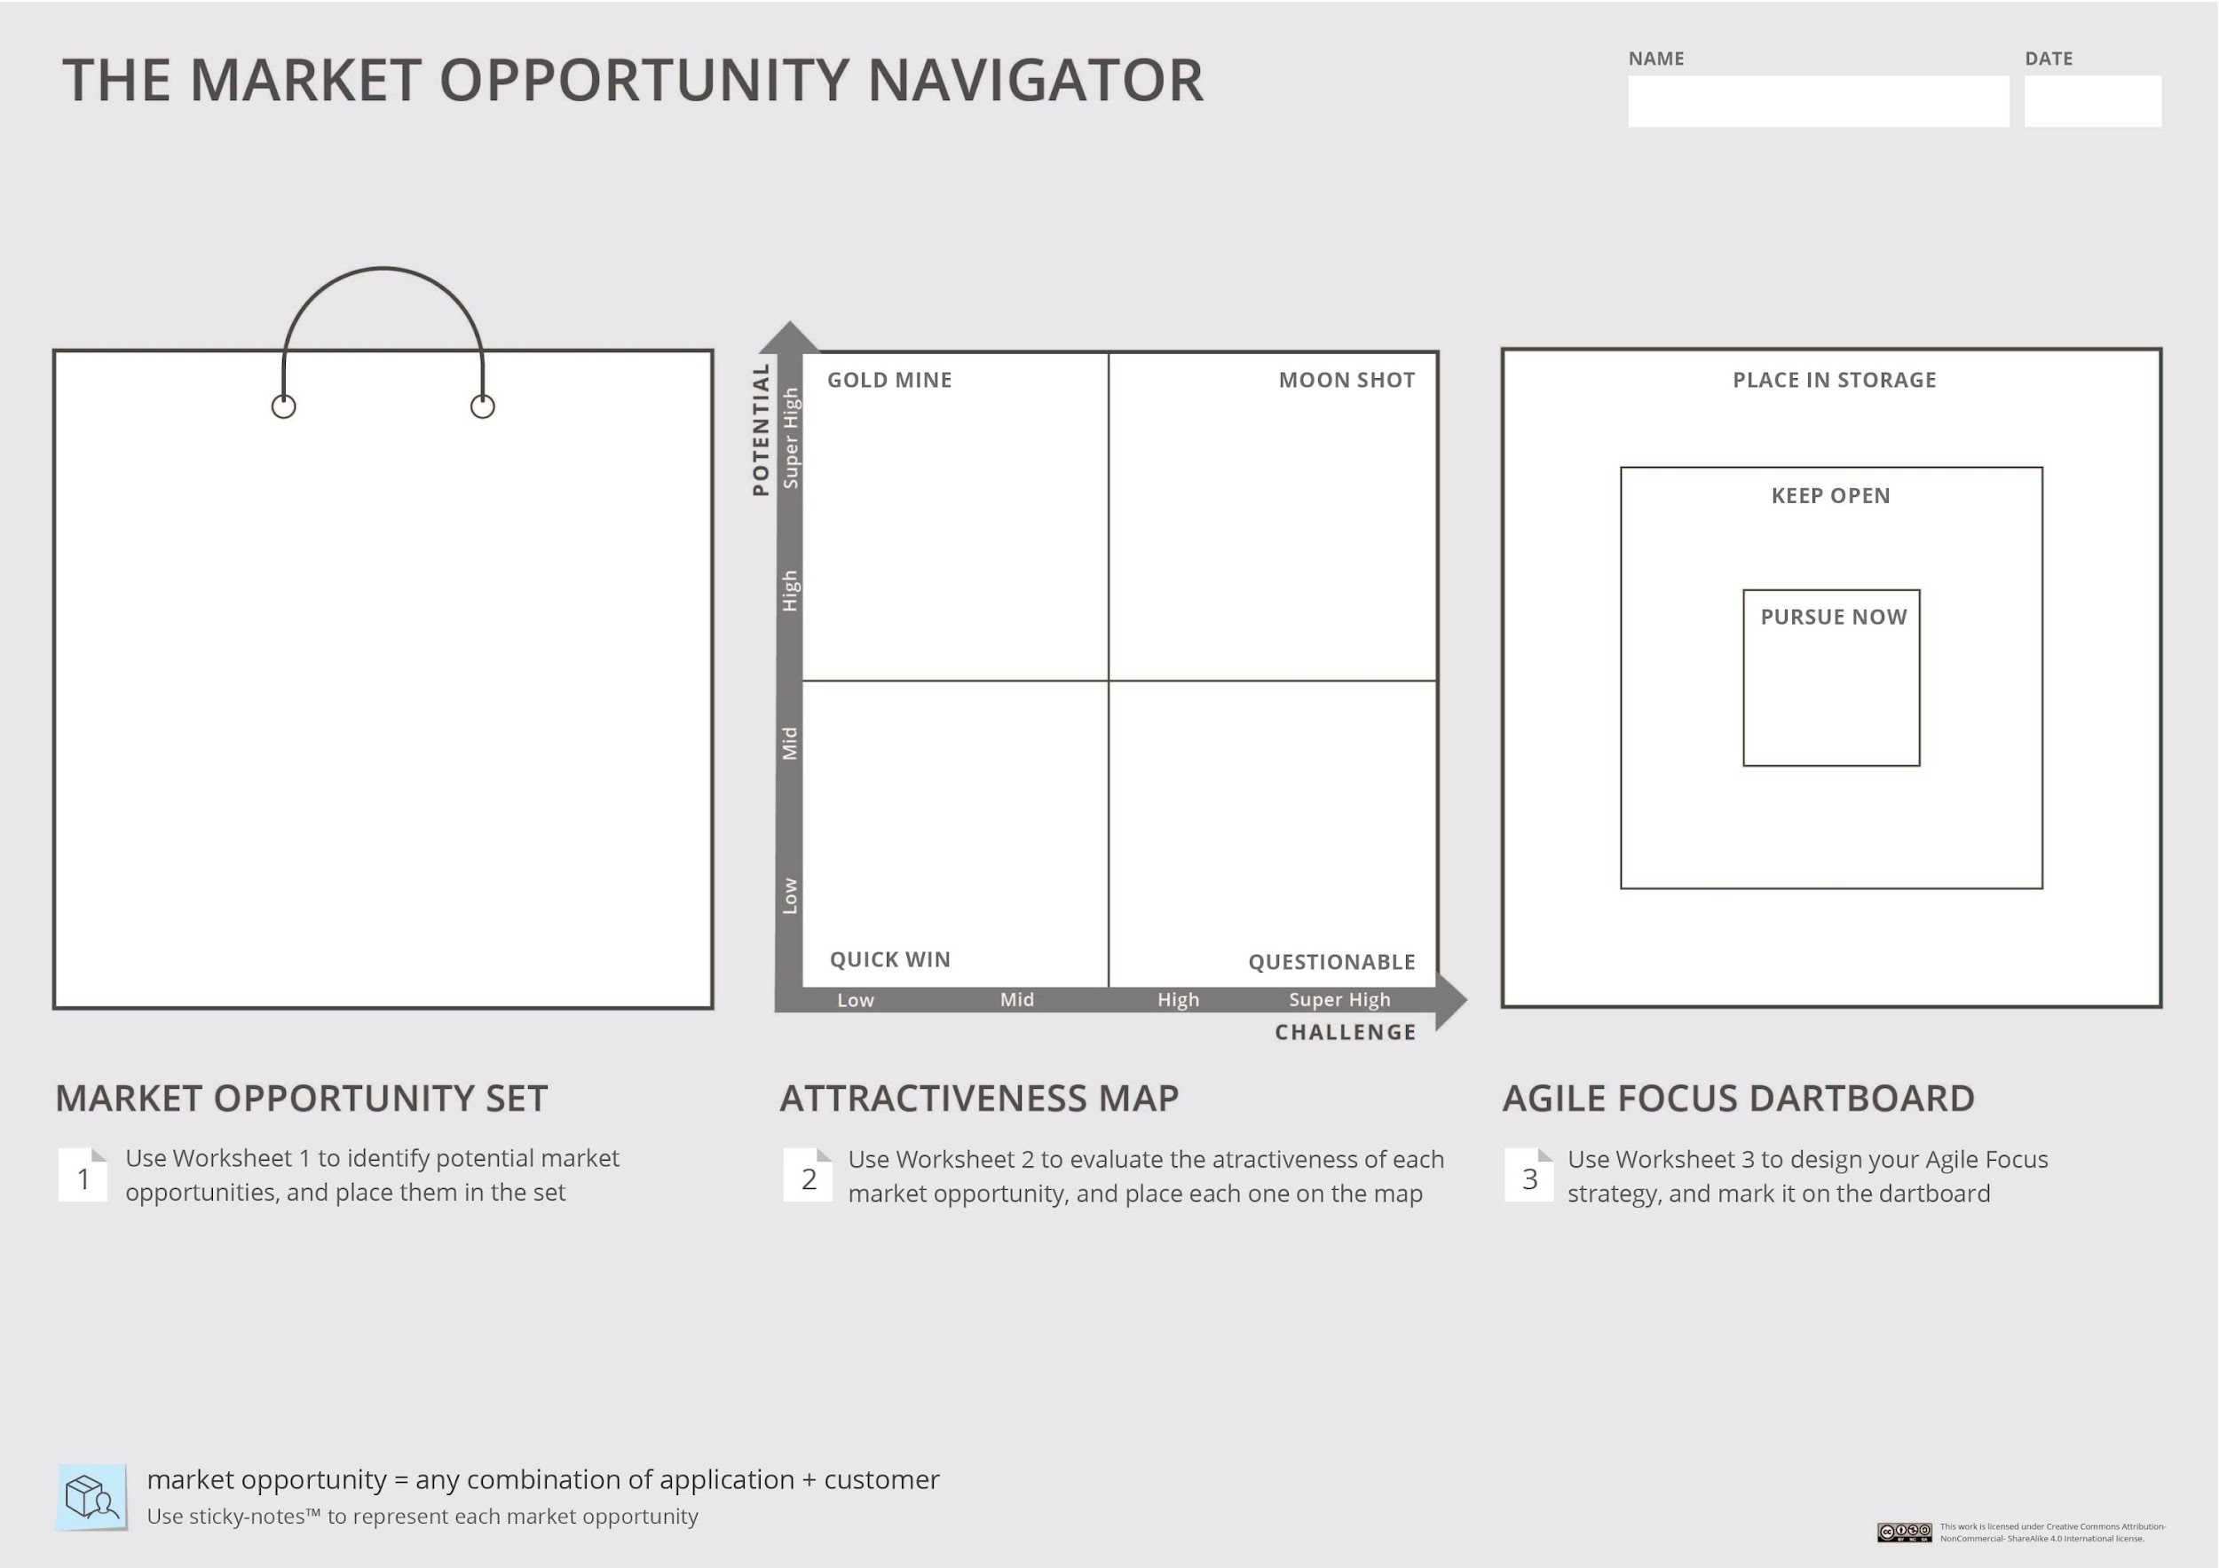
Instructions:
Choose 3-5 market opportunity that you want to further consider and depict them in your Market Opportunity Set. You can use the sticky notes below
Your project/ startup
When you label your options, remember that a market opportunity
is a combination of application & customers

